Slide 1


Craigslist Resume Filtering
Team Spartans

Slide 2






ABOUT US
Nitesh Wagh
Nikhitha Meela
Taronish Gotla
Aditya Gupta
Nikhil Katiki

Slide 3

01
Client Background
02
Problem Statement
03
Business Objective
Table of Contents
04
Approach
05
Data Collection
06
Text Representation
07
Data Modelling
08
Validation / Business Outcomes
09
Future Scope

Slide 4


Background of our client
Online Marketplace
Alternate to commerical sites
Focus of our Analysis – Resumes
Competitive Advantage
Scope for improvement

Slide 5
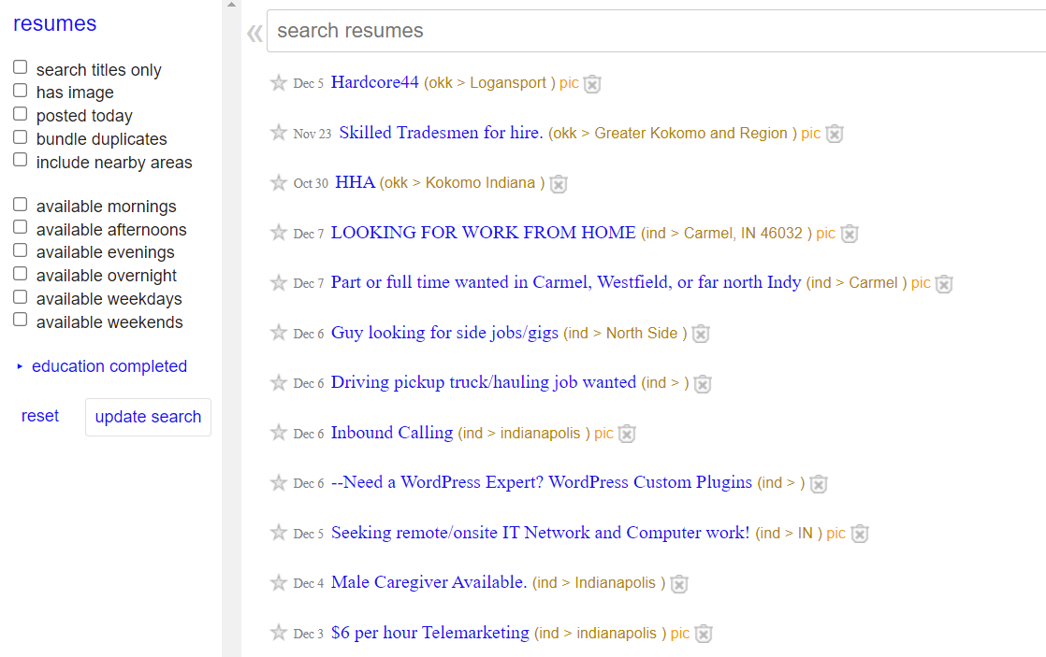
Problem Statement
Most resumes posted on Craigslist are highly unstructured
Harder for recruiters to find what they’re looking for!
Loss of user engagement on both ends
Competitive edge

Slide 6
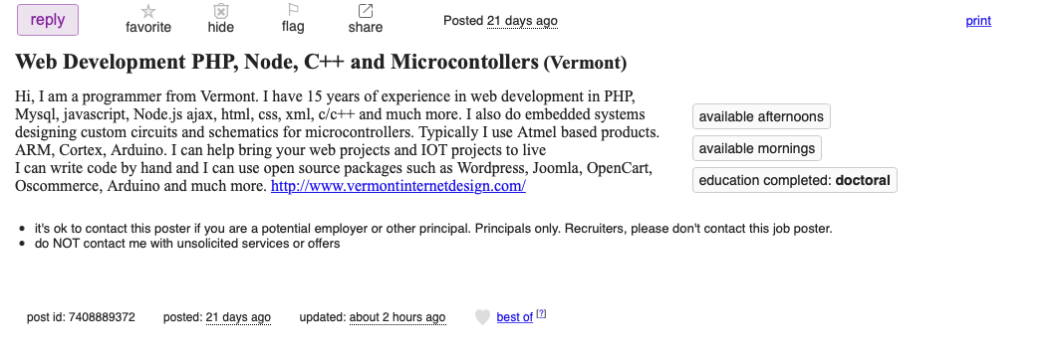
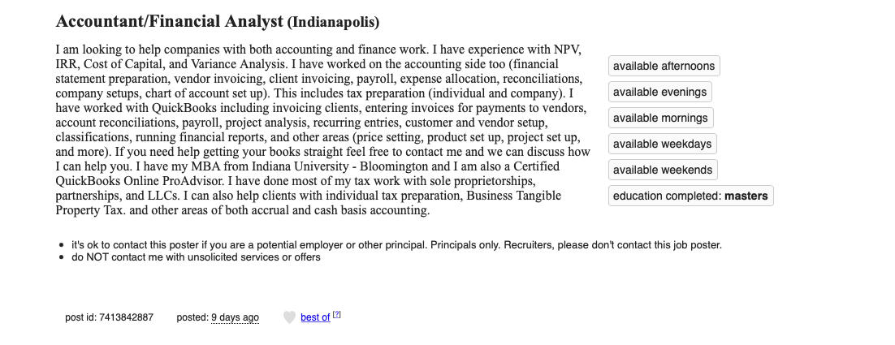
Business Objective
We intend to provide information about which industry (and job type) each candidate belongs to, making it easier for the recruiter
This will be accomplished by training our classification model on external data sources (Kaggle) and then testing it on Craigslist resume scrapes.
Proposed Solution
- Resume Classification and Industry Tagging
- Improved user experience
- Inaccurate search results due to spam posts

Slide 7
Approach
Scarp Craigslist resumes using Seleinium
Evaluate performance of various classification model
Data Collection Test
Modelling
Data Collection Train
Text Representation
Generate Tags
Collect train data from Kaggle containing industry wise classified resumes
Represent the unstructured text data into numerical format
Classify the test data using on the final model

Slide 8
Data Collection
Train
Data collected from multiple Kaggle sources
2200+ labelled resumes with 37 unique classes
Mix of Blue- and White-Collar classes
70/30 Train/Validation Split
Filtered Duplicate / Bad entries
Test
Data Scrapped from Craigslist.com
8 Metropolitan Cities
Selenium and BeautifulSoup

Slide 9

Text Representation
Classic Models
Remove URLs hashtags, punctuations, RTcc, whitespace
Remove Stopwords
Lemmatization
N Grams
Vectorization - TFIDF and Countvectorizer
LSTM
One hot encoding
Word Embedding

Slide 10
Modelling
For Basic Algorithms, the Count Vectorizer technique is performing well whereas Trees algorithms performed well when Tfidf is used for preprocessing
Despite it being multi-class, the accuracy is really promising Which may be due to the number of features

Slide 11

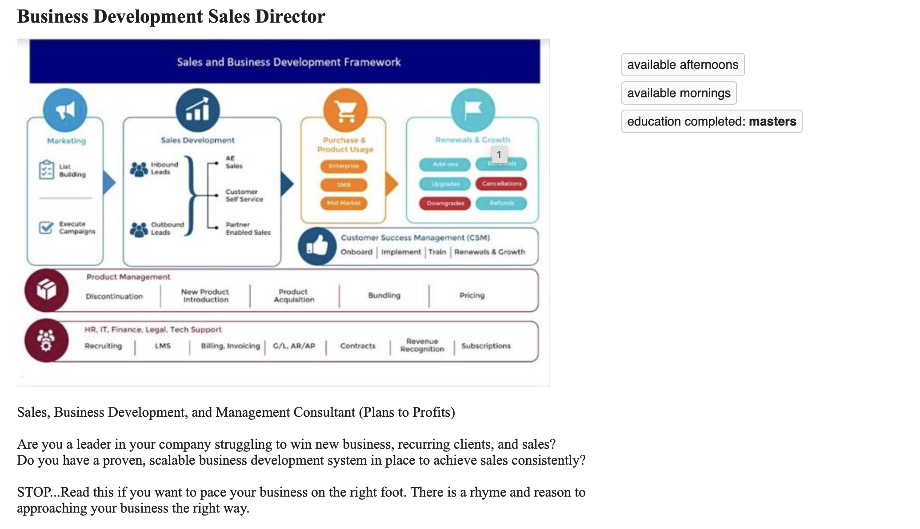
Validation

Slide 12
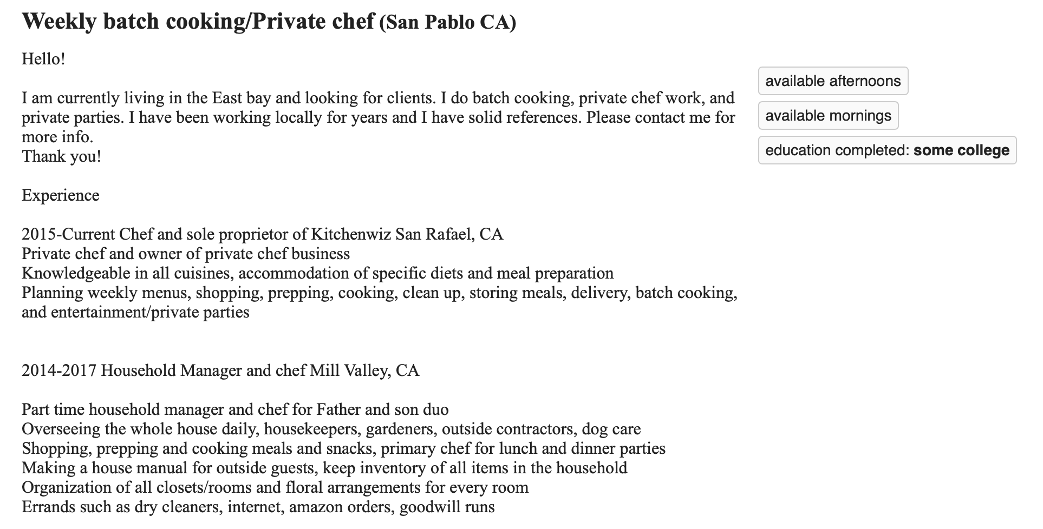
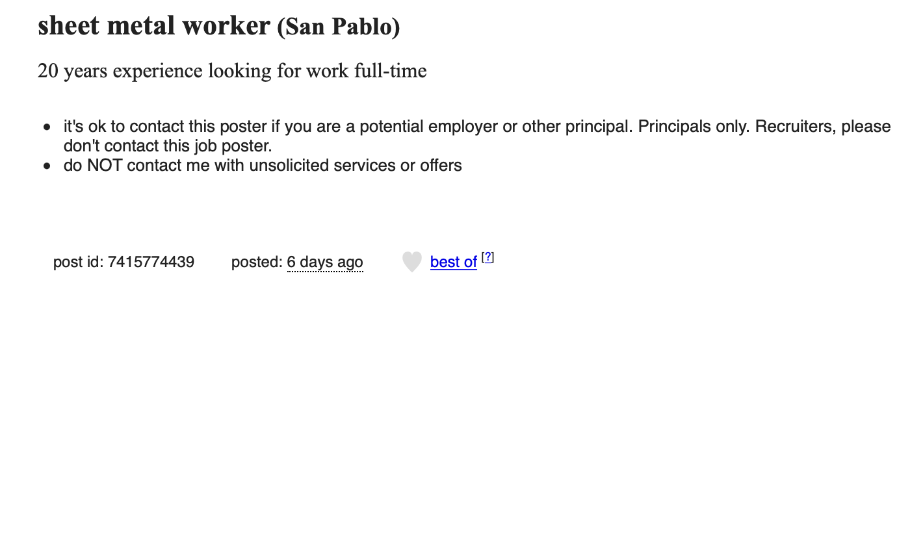
Validation - Misclassifications

Slide 13
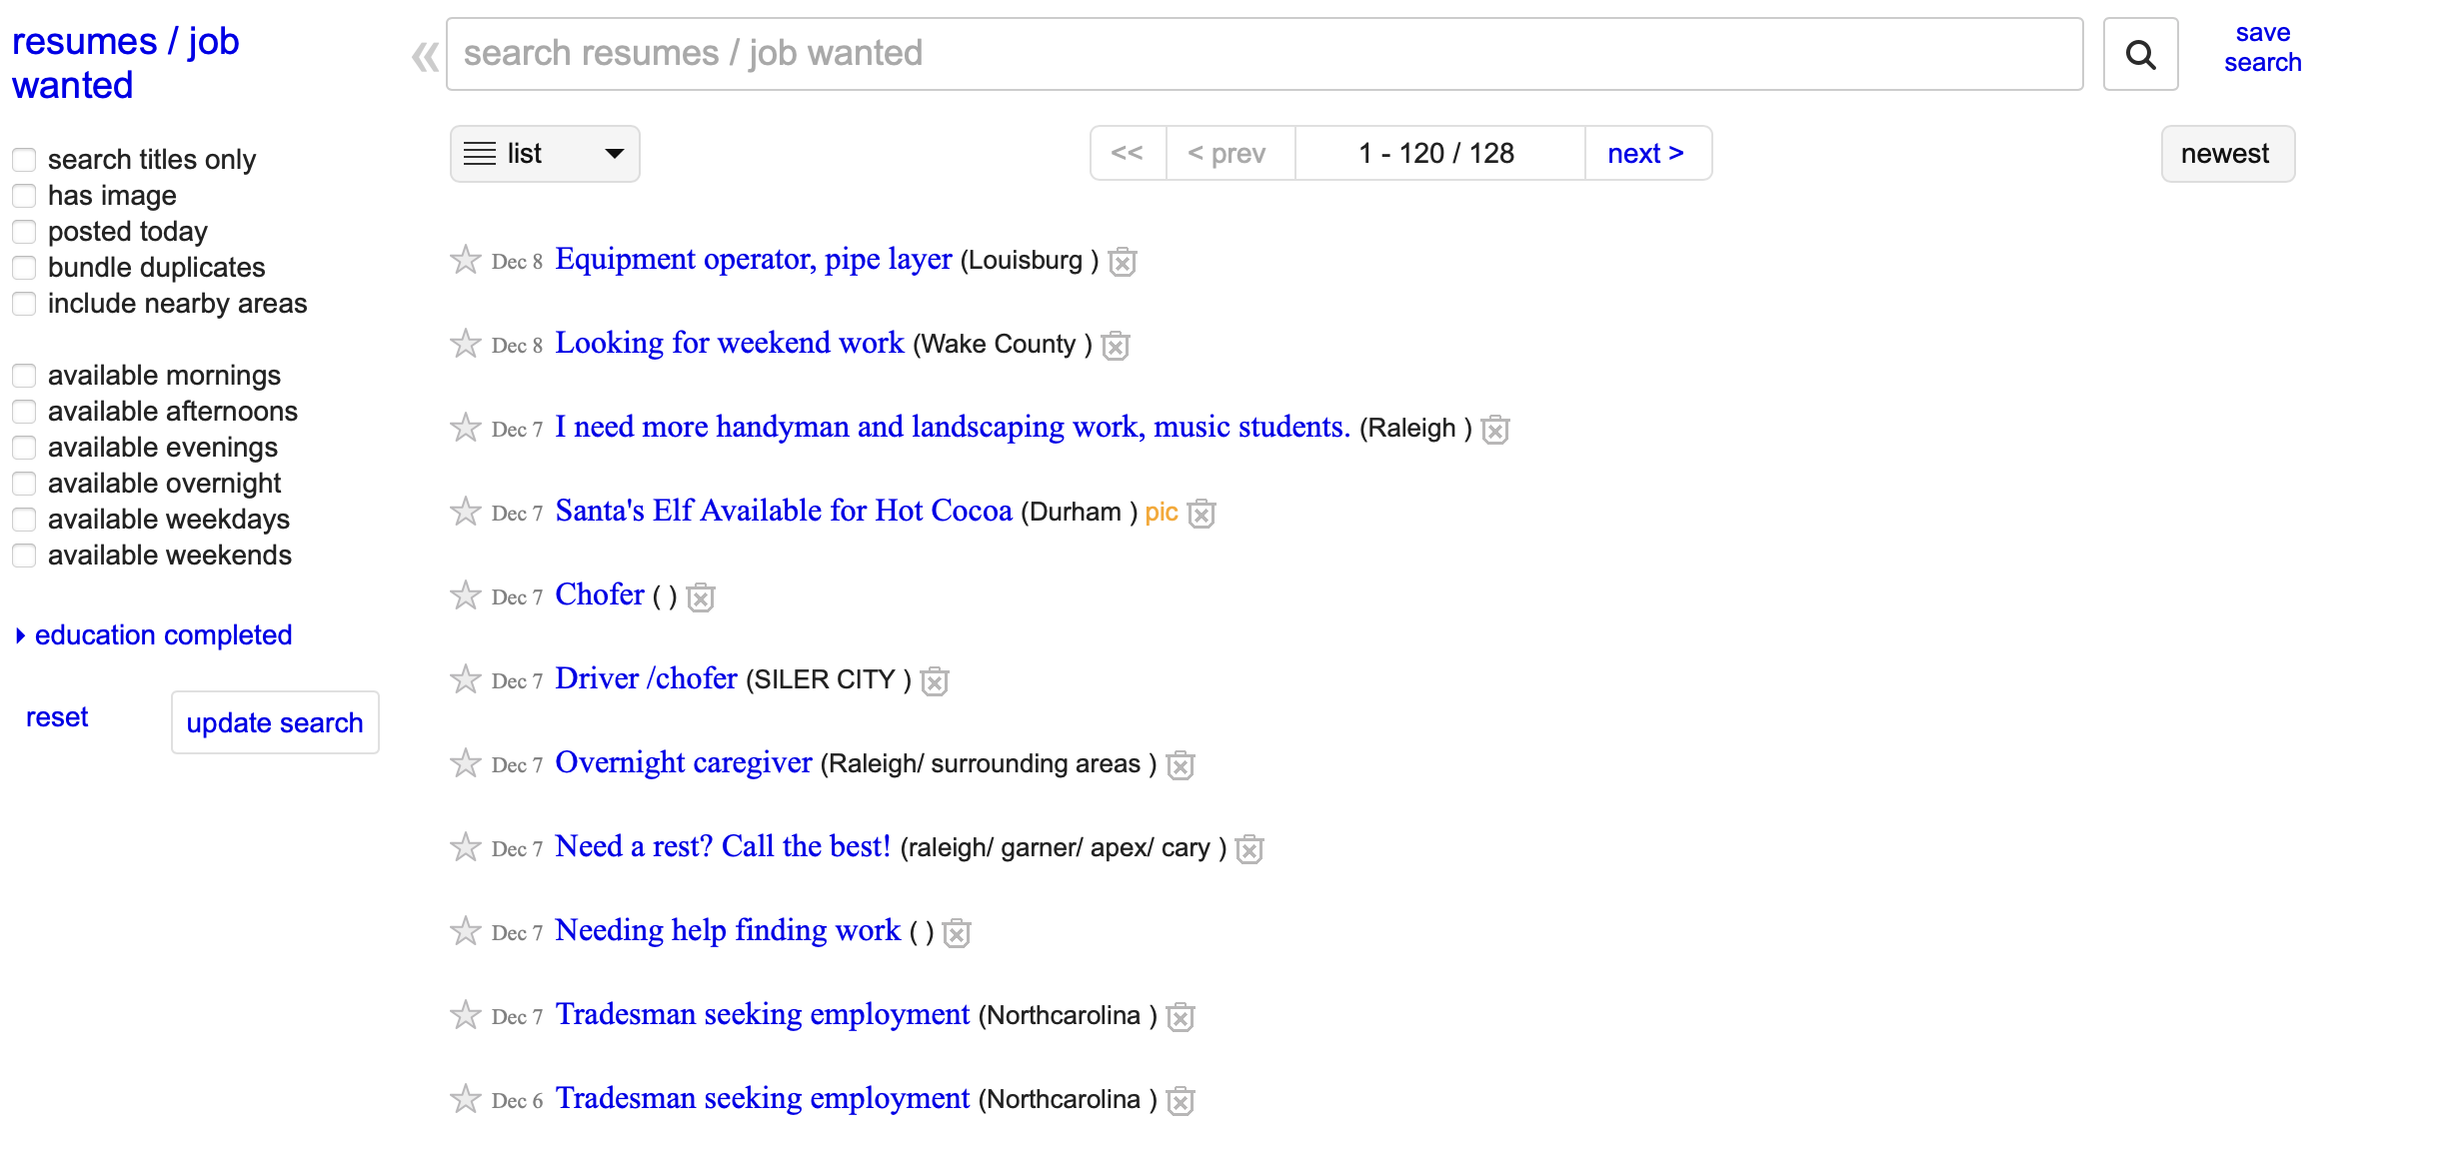
Business Outcomes
Resume based filter on Landing Page
Industry Tagging on Individual Resume Page
Advocate
Arts
Automation
Blockchain
BPO
Business Analyst
Boost recruiter traffic on Craigslist resume section
Business Development

Slide 14
Future Scope
Use Natural Language Search engine to match queries with tagged resumes
Obtain/create train data on blue collar jobs to get better classification
Match resumes with job description using clustering techniques for enhanced user experience
Extend the tagging feature for all cities in Craigslist

Slide 15

THANKS!

